Slide 1
Financial Management
By:
Dr. Sarveshwar Kumar Inani
sarveshwarinani@wilp.bits-pilani.ac.in

Slide 2
What is Cost of Capital
The discount rate used for calculating the present value of future cashflows is also called as the Cost of Capital (Or Opportunity cost of capital).
The return that an investor expect from any investment/securities is the cost of capital for that company that issues (Required rate of return).
The Financing Decision of Financial Management calls for sourcing of fund for the business which decides Capital Structure of the company.
There are mainly two components of this Capital : Equity and Debt
Equity Capital includes equity shares, preference shares and retained earnings or reserves and surplus.
Debt Capital includes long-term and short-term borrowings and debt securities.

Slide 3
Applications of Cost of Capital
Evaluates investment projects
Determines the capital structure

Slide 4
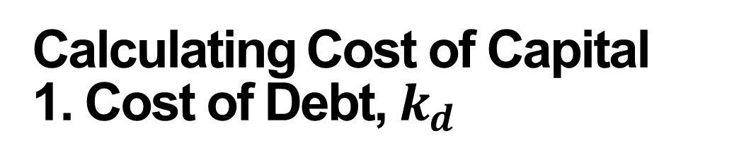
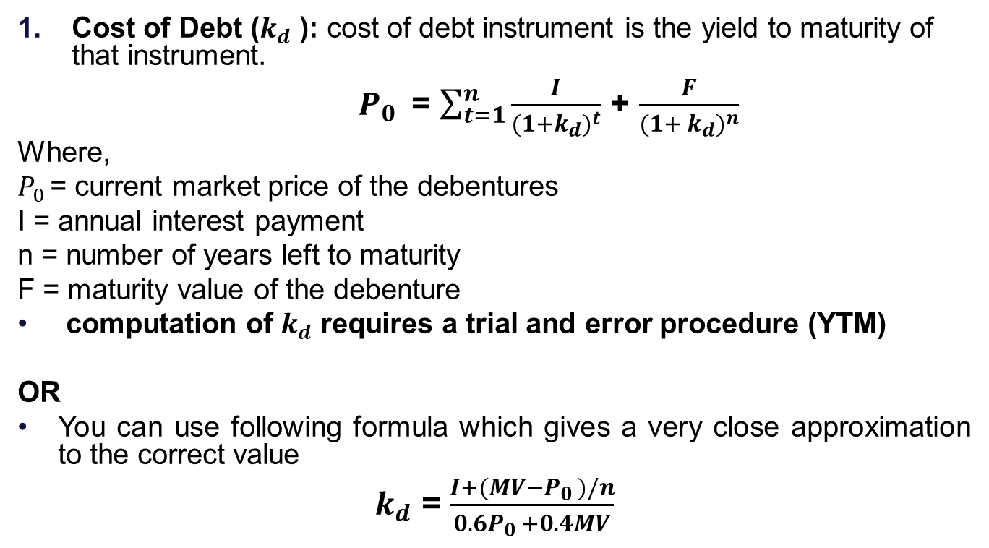
Calculating Cost of Capital
1. Cost of Debt, $k_{d}$
Cost of Debt ($k_{d}$ ): cost of debt instrument is the yield to maturity of that instrument.
$P_{0 }$ = $\sum_{t=1}^{n}{\frac{I}{{(1+k_{d})}^{t}}}$ + $\frac{F}{{(1+ k_{d})}^{n}}$
Where,
$P_{0 }$= current market price of the debentures
I = annual interest payment
n = number of years left to maturity
F = maturity value of the debenture
computation of $k_{d}$ requires a trial and error procedure (YTM)
OR
You can use following formula which gives a very close approximation to the correct value
$k_{d}$ = $\frac{I+(MV−P_{0 })/n}{0.6P_{0 }+0.4MV}$

Slide 5
Exercise 1
Abacus Ltd. Issued 15 years, 14 per cent bonds five years ago. The bond which has a face value of Rs. 100 is currently selling for Rs. 108.
What is the pre-tax cost of debt?
What is the after-tax cost of debt? (assume a 35 per cent tax rate)

Slide 6
Exercise 2
XYZ Ltd. Can sell 7 years, 15% $100 debenture at net price of $ 97.75. Such debentures will be redeemed at 5% premium on maturity. The corporate tax rate is 35%.
What is the pre-tax cost of debt?
What is the after-tax cost of debt? (assume a 35 per cent tax rate)

Slide 7
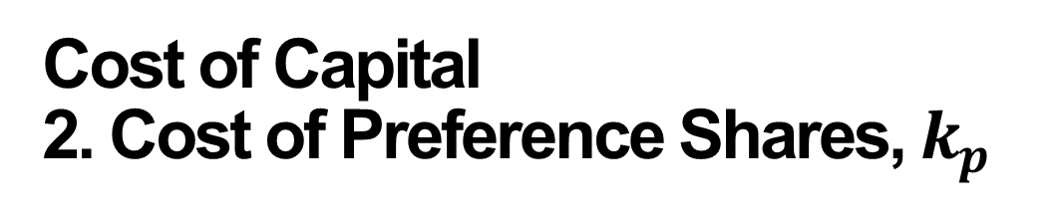
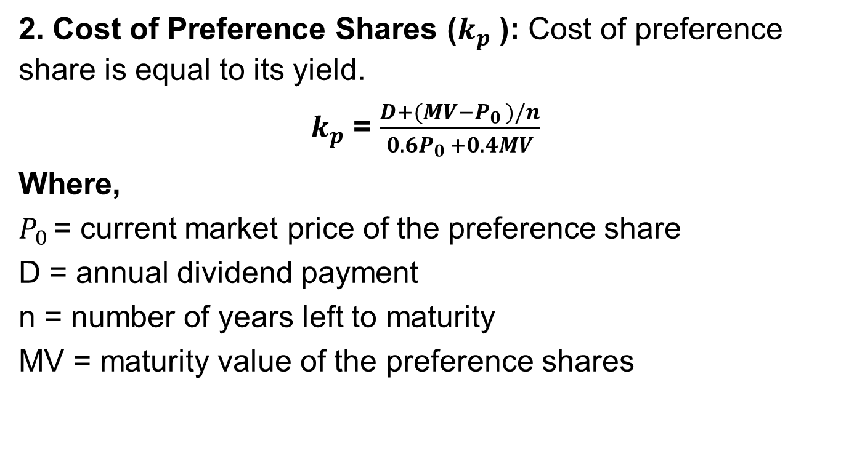
Cost of Capital
2. Cost of Preference Shares, $k_{p}$
2. Cost of Preference Shares ($k_{p}$ ): Cost of preference share is equal to its yield.
$k_{p}$ = $\frac{D+(MV−P_{0 })/n}{0.6P_{0 }+0.4MV}$
Where,
$P_{0 }$= current market price of the preference share
D = annual dividend payment
n = number of years left to maturity
MV = maturity value of the preference shares

Slide 8
Exercise 3
Omega Enterprises issued 10 year, 9 per cent preference shares four years ago. The preference share which has a face value of Rs.100 is currently selling for Rs. 92. what is the cost of preference shares?

Slide 9
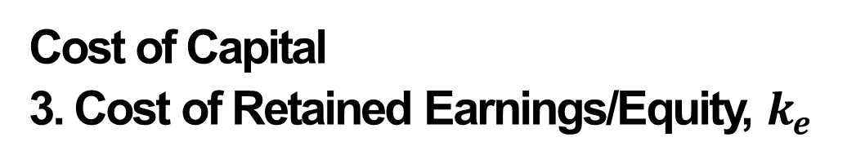
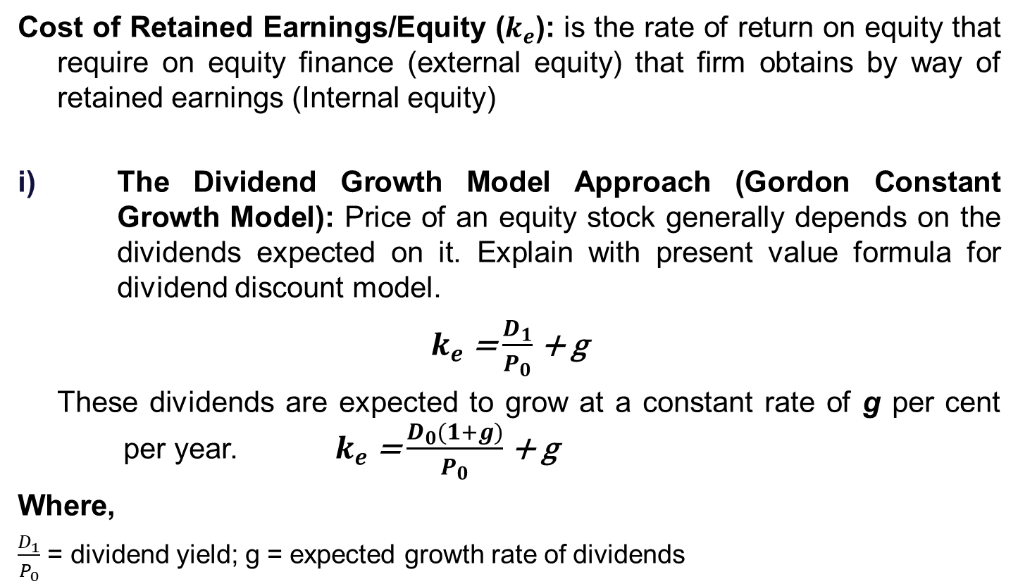
Cost of Capital
3. Cost of Retained Earnings/Equity, $k_{e}$
Cost of Retained Earnings/Equity ($k_{e}$): is the rate of return on equity that require on equity finance (external equity) that firm obtains by way of retained earnings (Internal equity)
The Dividend Growth Model Approach (Gordon Constant Growth Model): Price of an equity stock generally depends on the dividends expected on it. Explain with present value formula for dividend discount model.
$k_{e}$ = $\frac{D_{1}}{P_{0}}$ + g
These dividends are expected to grow at a constant rate of g per cent per year. $k_{e}$ = $\frac{D_{0}(1+g)}{P_{0}}$ + g
Where,
$\frac{D_{1}}{P_{0}}$ = dividend yield; g = expected growth rate of dividends

Slide 10
Exercise 4
The market price per share of a company is Rs.17.00. The dividend expected a year hence is Rs.1.00. The expected rate of dividend growth is 8 per cent. What is the cost of equity capital of the company?

Slide 11
Practice questions in class
Q1. A company has a current dividend of Rs. 3.00 per share, which is expected to grow at a constant rate of 6% per year. If the market price per share is Rs. 45.00, what is the required rate of return on the stock? (Solution: 13.07%)
Q2. A company has a current dividend of Rs. 5.00 per share, which is expected to grow at a constant rate of 10% per year. If the market price per share is Rs. 60.00, what is the required rate of return on the stock? (Solution: 19.17%)

Slide 12
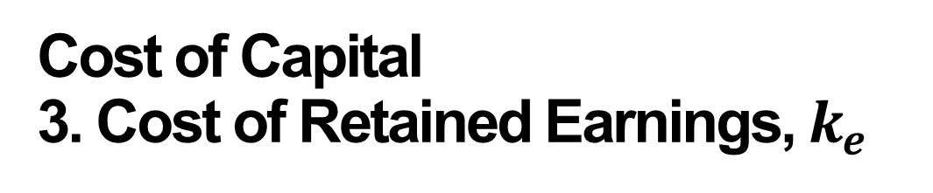
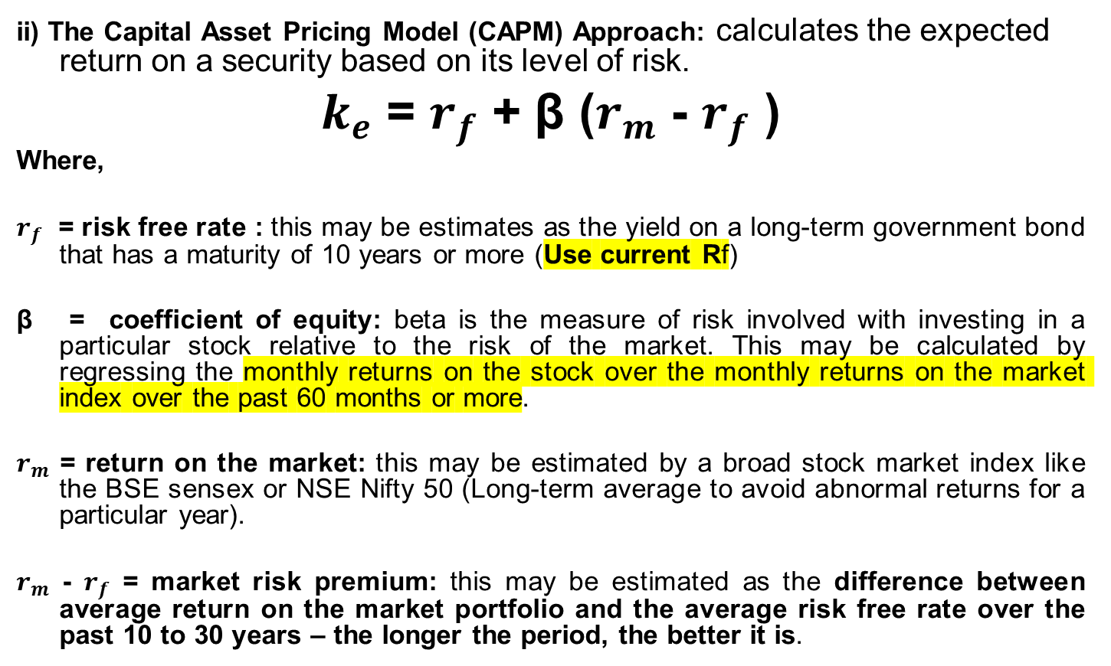
Cost of Capital
3. Cost of Retained Earnings, $k_{e}$
ii) The Capital Asset Pricing Model (CAPM) Approach: calculates the expected return on a security based on its level of risk.
$k_{e}$ = $r_{f}$ + β ($r_{m}$ - $r_{f}$ )
Where,
$r_{f}$ = risk free rate : this may be estimates as the yield on a long-term government bond that has a maturity of 10 years or more (Use current Rf)
β = coefficient of equity: beta is the measure of risk involved with investing in a particular stock relative to the risk of the market. This may be calculated by regressing the monthly returns on the stock over the monthly returns on the market index over the past 60 months or more.
$r_{m}$ = return on the market: this may be estimated by a broad stock market index like the BSE sensex or NSE Nifty 50 (Long-term average to avoid abnormal returns for a particular year).
$r_{m}$ - $r_{f}$ = market risk premium: this may be estimated as the difference between average return on the market portfolio and the average risk free rate over the past 10 to 30 years – the longer the period, the better it is.

Slide 13
Exercise 5
The risk-free rate is 8 per cent and the return on market portfolio is 12 per cent. Calculate the required rate of return on the three equity stocks with the beta values shown against them.
Stock | Beta
A | 0.8
B | 1.2
C | 1.7

Slide 14
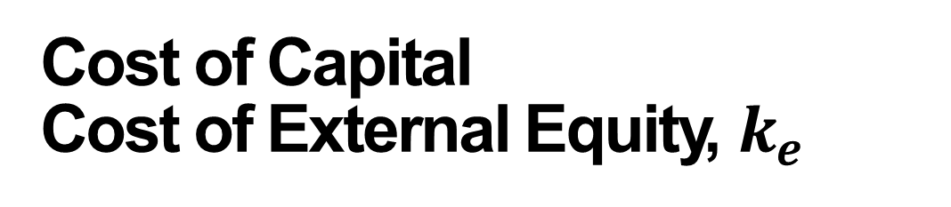
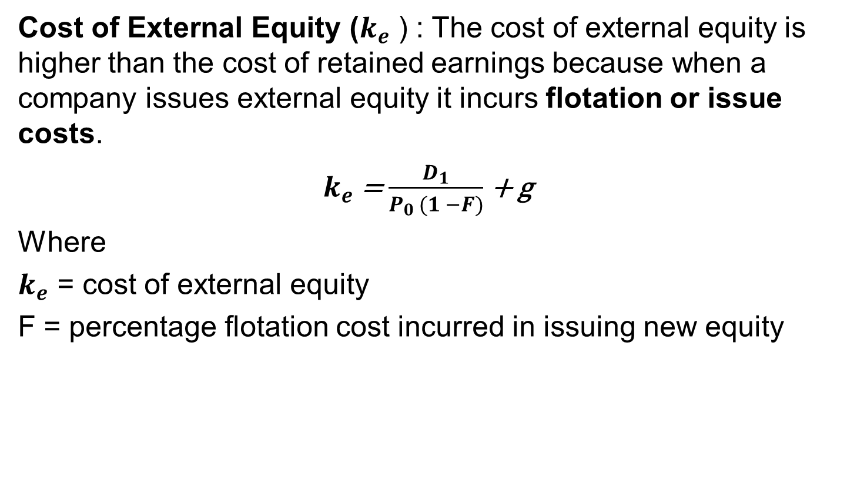
Cost of Capital
Cost of External Equity, $k_{e}$
Cost of External Equity ($k_{e}$ ) : The cost of external equity is higher than the cost of retained earnings because when a company issues external equity it incurs flotation or issue costs.
$k_{e}$ = $\frac{D_{1}}{P_{0 }(1 −F)}$ + g
Where
$k_{e}$ = cost of external equity
F = percentage flotation cost incurred in issuing new equity

Slide 15
Exercise 6
The current market price per share of Vishnu Ceramics is Rs.75. The dividend expected a year from now is Rs. 2.5 and it is expected to grow at a constant rate of 12 per cent. The flotation cost for the new issue will be 8 per cent. What is the cost of new equity?

Slide 16
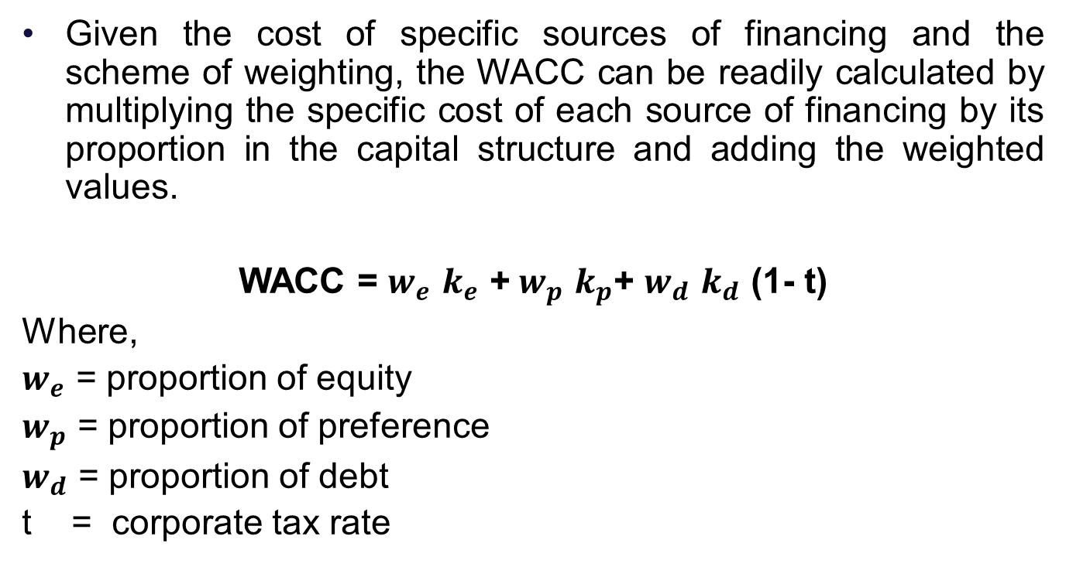
Weighted Average Cost of Capital (WACC)
Given the cost of specific sources of financing and the scheme of weighting, the WACC can be readily calculated by multiplying the specific cost of each source of financing by its proportion in the capital structure and adding the weighted values.
WACC = $w_{e}$ $k_{e}$ ${\text{+} w}_{p}$ $k_{p}$+ $w_{d}$ $k_{d}$ (1- t)
Where,
$w_{e}$ = proportion of equity
$w_{p}$ = proportion of preference
$w_{d}$ = proportion of debt
t = corporate tax rate

Slide 17
Practice Problem
The capital structure of V K Funds Ltd. in book value terms is a follows (Explain Book value vs market value)
Source of Finance | Amount in Millions
Equity Capital (20 million shares, Rs.10/share) | Rs. 200 M
Preference Capital, 12 per cent (500,000 shares, Rs. 100/share) | Rs. 50 M
Retained earnings | Rs. 350 M
Debentures 14 per cent (1200000 debentures, Rs. 100 par) | Rs. 120 M
Term Loans, 13 per cent | Rs. 80 M
Total | Rs. 800 M

Slide 18
Practice Problem
The next expected dividend per share is Rs. 2. The dividend per share is expected to grow at the rate of 12 per cent. The market price per share is Rs. 50. Preference stock, redeemable after 10 years, is currently selling for Rs. 85 per share. Debentures, redeemable after 5 years, are selling for Rs. 90 per debenture. The tax rate for the company is 30 per cent. Calculate the weighted average cost of capital.

Slide 19
Practice
A company has a debt-to-equity ratio of 0.75. If the cost of debt is 8% (before tax) and the cost of equity is 12%, what is the weighted average cost of capital (WACC) assuming a tax rate of 30%? (Solution: 9.26%)
A company has a beta of 1.2. If the risk-free rate is 5% and the market risk premium is 8%, what is the cost of equity using the Capital Asset Pricing Model (CAPM)? (Solution: 14.6%)
A company has a cost of debt (before tax) of 7% and a cost of equity of 11%. If the debt-to-equity ratio is 0.6, what is the WACC assuming a tax rate of 35%? (Solution: 8.59%)

Slide 20
Practice:
A company has a debt-to-equity ratio of 0.9. If the cost of debt (before tax) is 6% and the cost of equity is 14%, what is the WACC assuming a tax rate of 40%? (Solution: 9.08%)
A company has a beta of 1.3. If the risk-free rate is 4% and the market risk premium is 10%, what is the cost of equity using the CAPM? (Solution: 17%)
A company has a beta of 1.3. If the risk-free rate is 5% and the market risk premium is 8%, what is the cost of equity using the Capital Asset Pricing Model (CAPM)? (Solution: 15.4%)

Slide 21
THANK YOU!!!

